Slide 1
EBIXCASH
Securitization

Slide 2
Securitization
Securitization is a powerful tool for banks to manage risk and improve liquidity.
By pooling assets and creating securities backed by those assets, banks can transfer risk to investors and access additional funding sources
securitization also comes with risks, such as credit risk and liquidity risk.
Investors also need to assess the credit risk and liquidity risk associated with securitized products.

Slide 3
Securitization Flow
Masters
Funder Master
MHP Master
MRR% Master
Securitization Product Master
Trustee Master
Transactions
Securitization
Download
Securitization
Upload
Securitization
Pool
Removal
Contract
Creation
Screen
Funder
Schedule
Pay out file generate (Batch)
Funder Receipts
Funder Charges Booking
Funder Payment Entry
Funder Payable Summary
Funder Receivable Summary
Funder Billing History

Slide 4
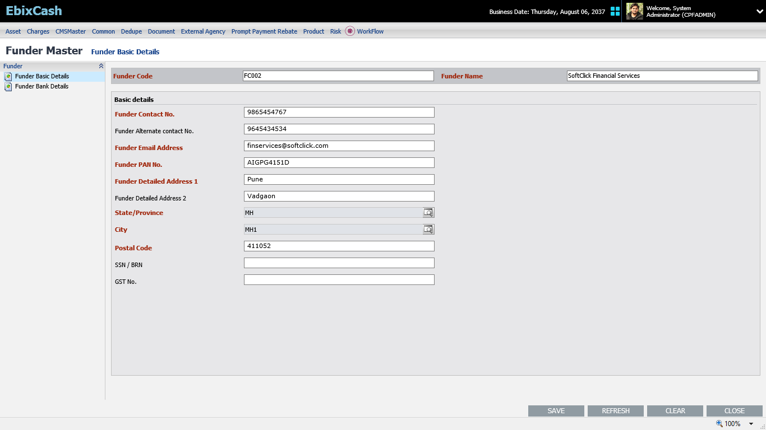
Funder Master
On funder Master screen we capture funder contact details along with his bank details, adding of new funder, activate, deactivate the funder.
Path – LMS →Masters→ Funder Master.

Slide 5
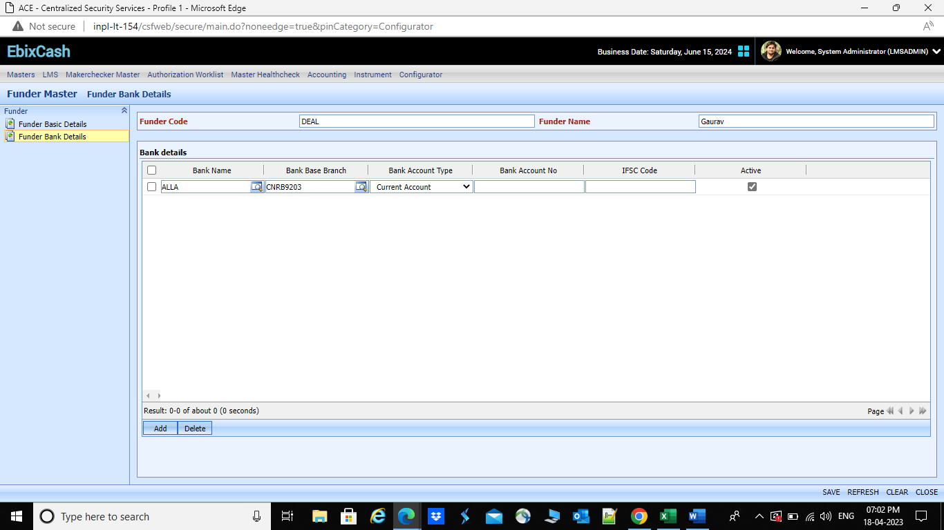

Slide 6
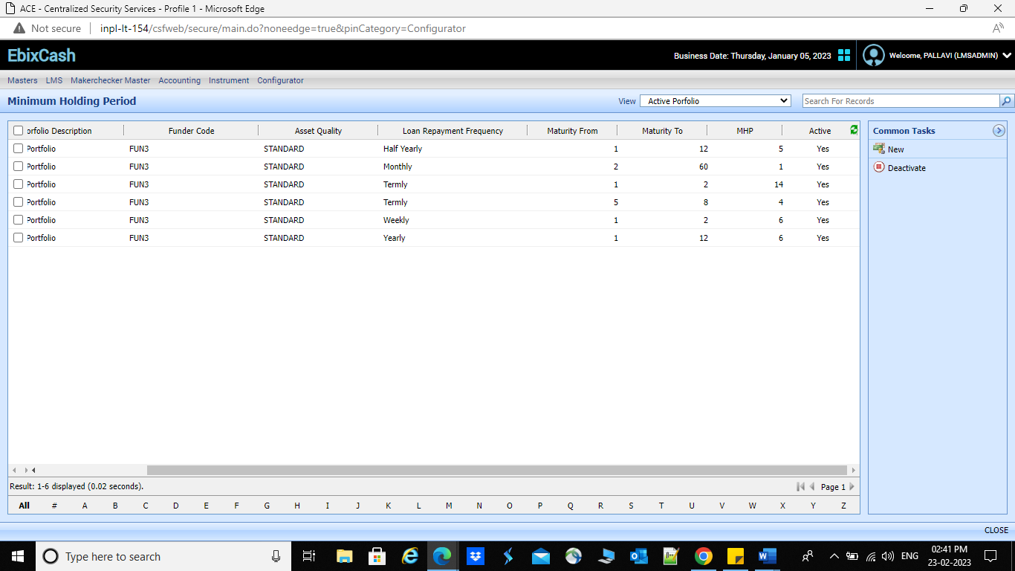
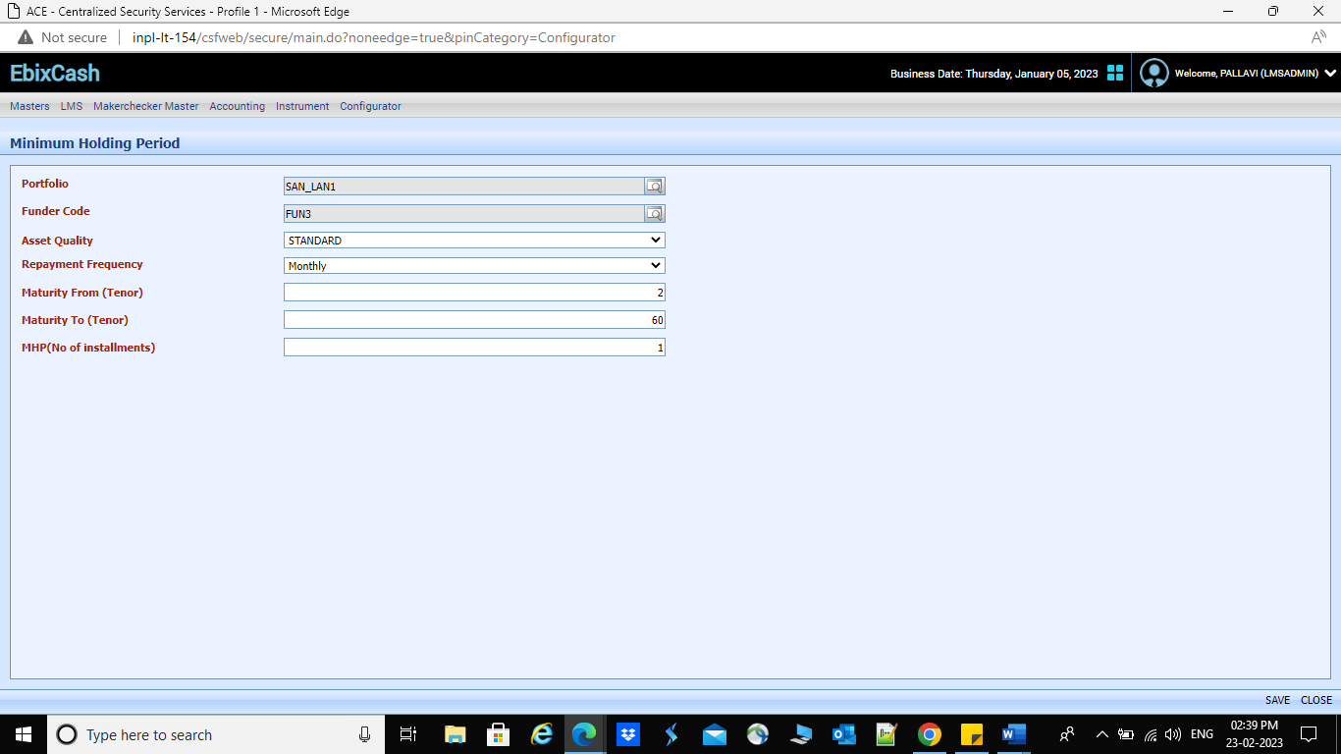
Minimum Holding Period
Here, this screen acts as filtration screen. The loans which are fulfilling the MHP master conditions and securitization download screen parameters will be download in securitization download screen and those loan accounts are eligible for securitization.
Path – LMS→ Masters→ Securitization →MHP

Slide 7
Master Condition

Slide 8
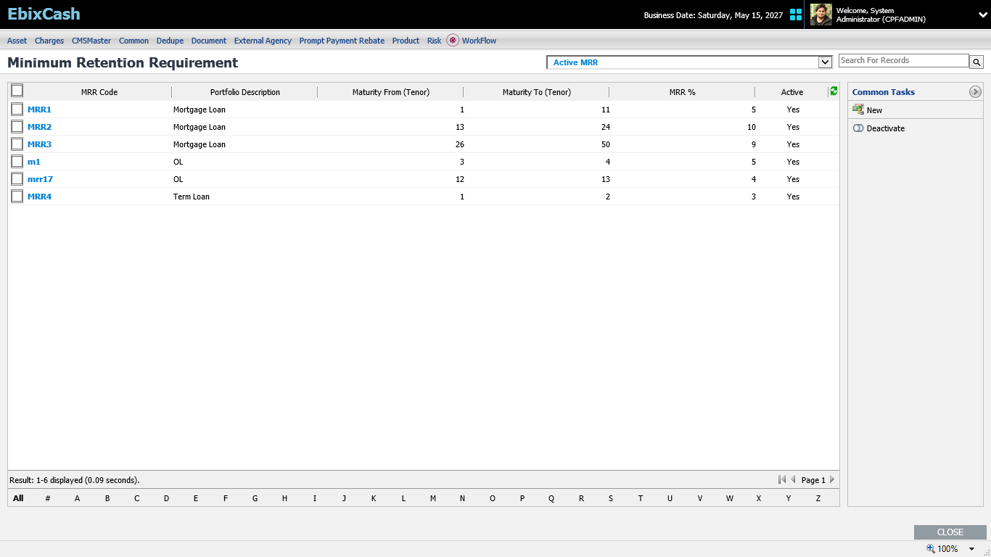
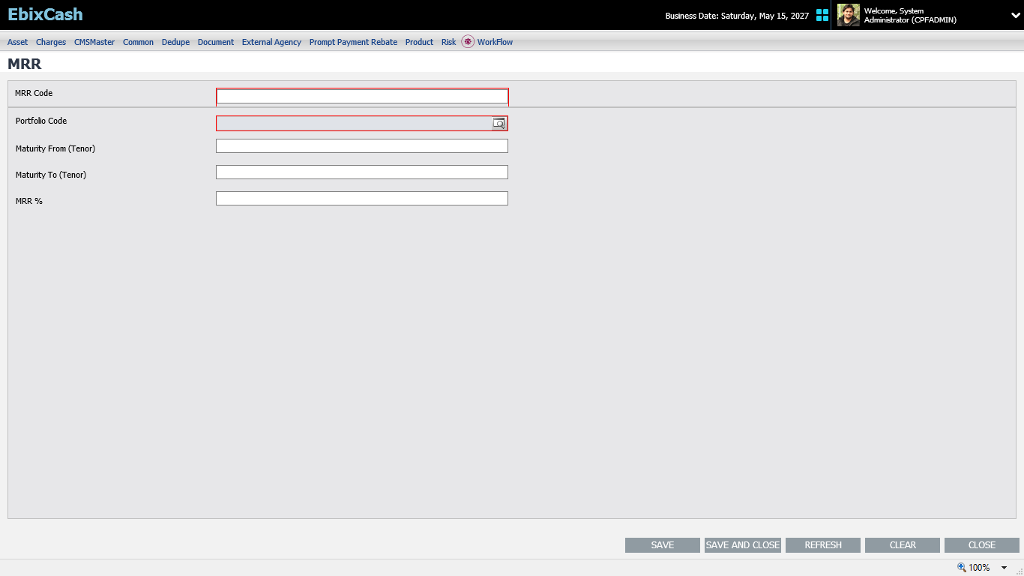
Minimum Retention Requirement
Here, MRR % according to repayment frequency and tenor wise of customer loan will configure. This configured MRR %ge will download along with download excel under separate column through securitization download screen against each loan which is available for securitization.
Path - LMS→ Master→ Securitization →MRR

Slide 9
Master Condition
If Loan original maturity period is <= 24 Months, MRR =5% of the book value of the loans being securitized.
If Loan original maturity period is >24 Months, MRR =10% of the book value of the loans being securitized.

Slide 10
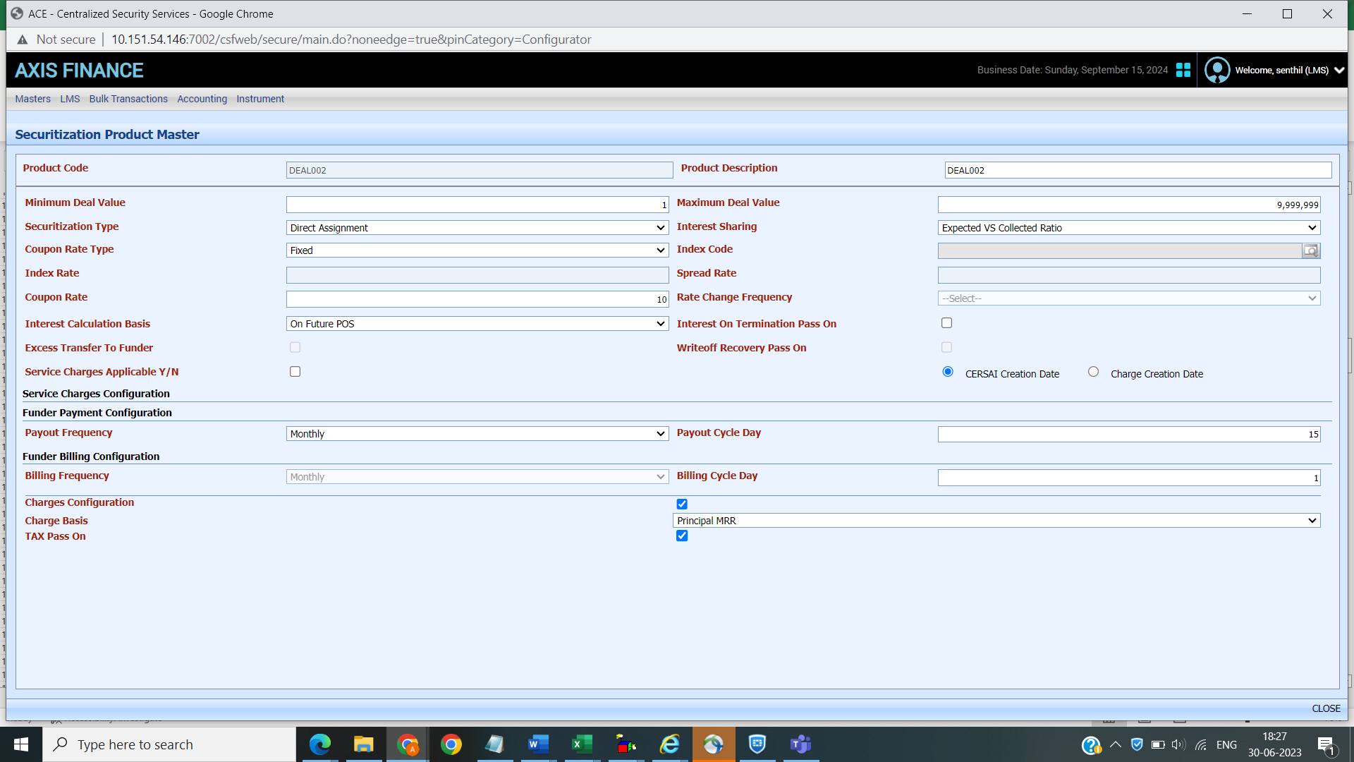
Securitization Product Master
From this screen we can create the securitization product.
This screen is used to set the default value for Securitization contract creation screen.

Slide 11
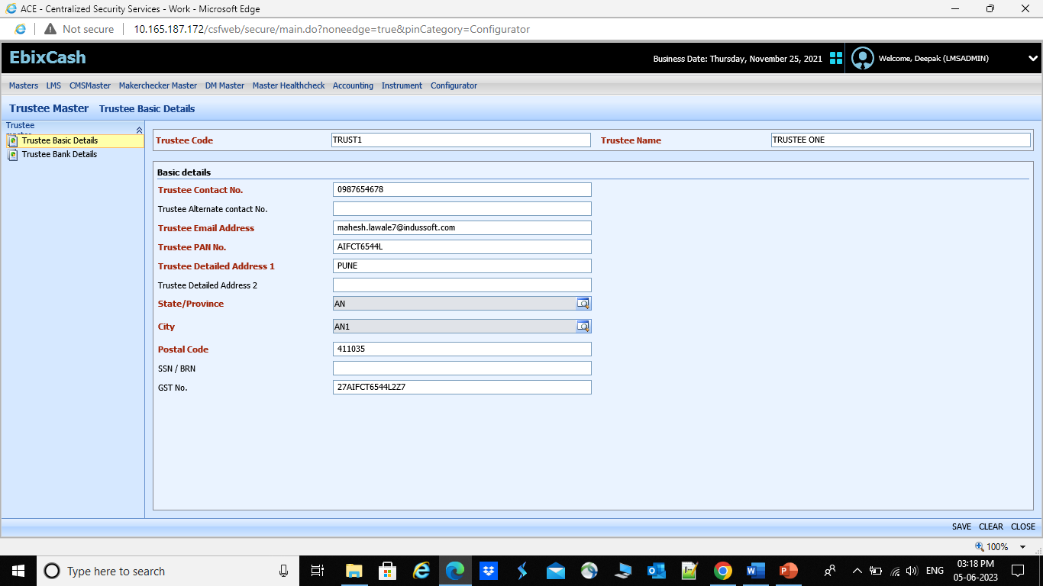
Trustee Master
On Trustee Master screen we capture Trustee contact details along with his bank details, adding of new Trustee, activate, deactivate the Trustee.
If along with funder there is Trustee also involve in the deal, then Trustee details need to capture through this screens.
Path – LMS →Masters→ Trustee Master.

Slide 12
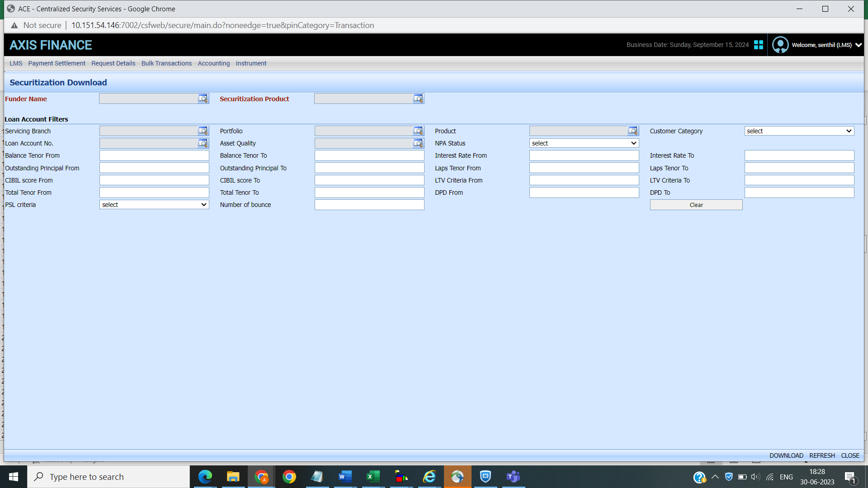
Securitization download
Once MHP master is created in master user can download the data for securitization from this screen. Loans which are filter from MHP master screen will be downloaded, only this account can be securitized.
Once file get downloaded, this file is sent to funder to finalized the loan that he wants to securitized.
Once the funder finalize the loan account list for securitization, the file get upload in system through bulk upload option, as soon as file get upload in system securitization pool id created by system.
Path – LMS →Securitization →Securitization Download

Slide 13
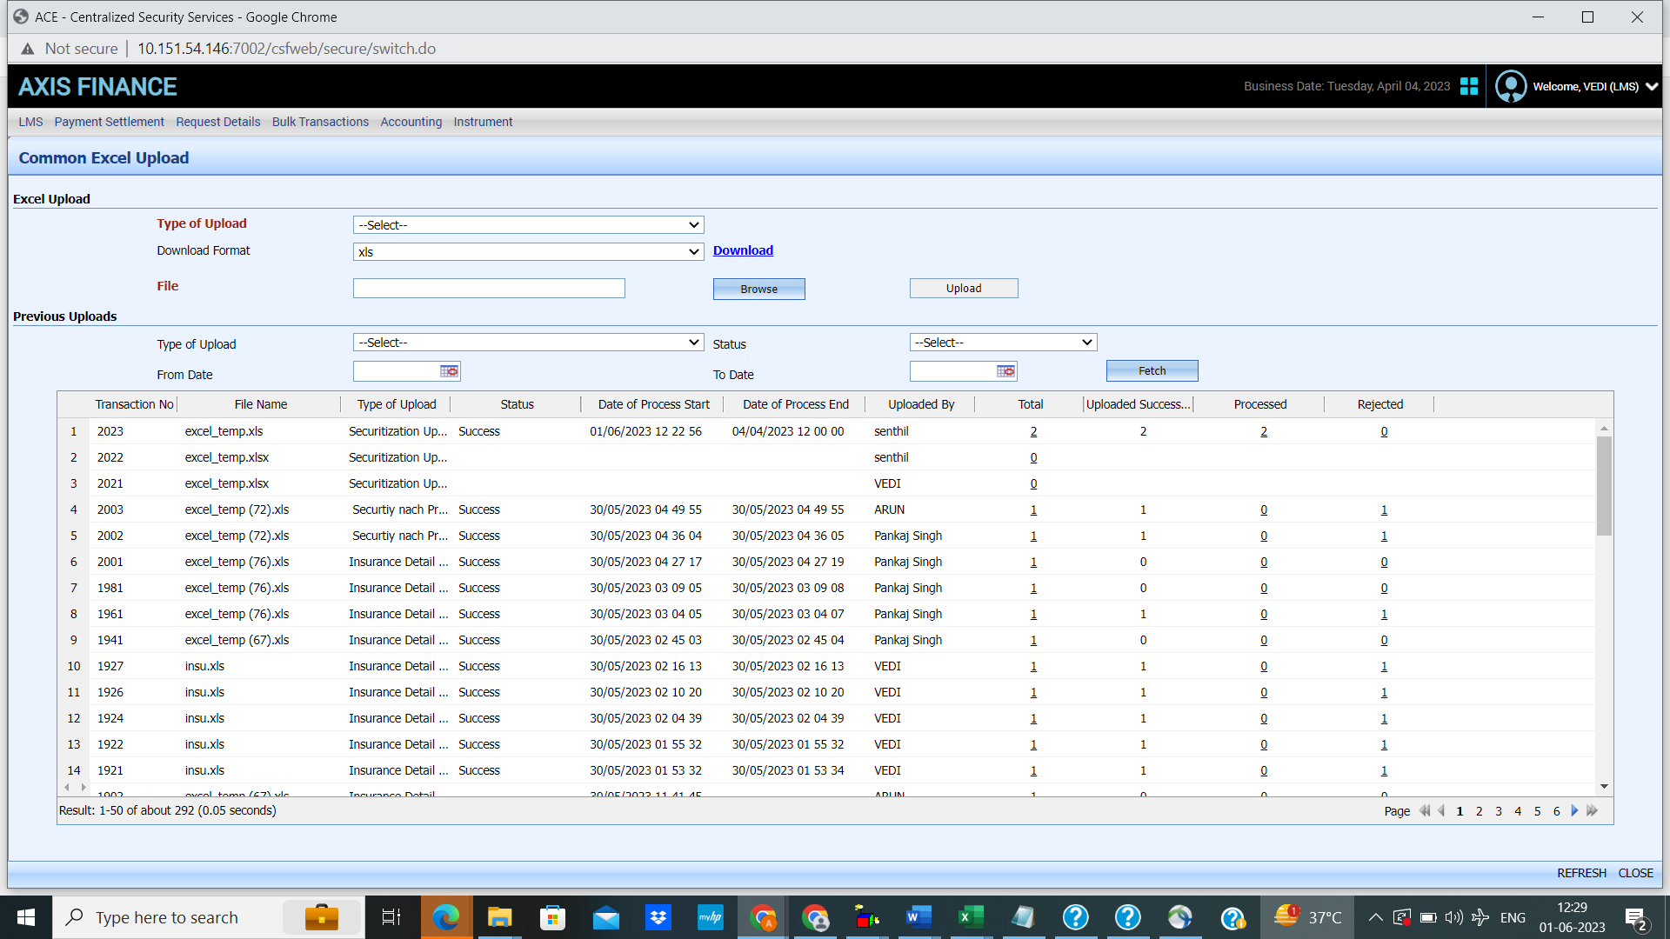
Securitization Upload

Slide 14
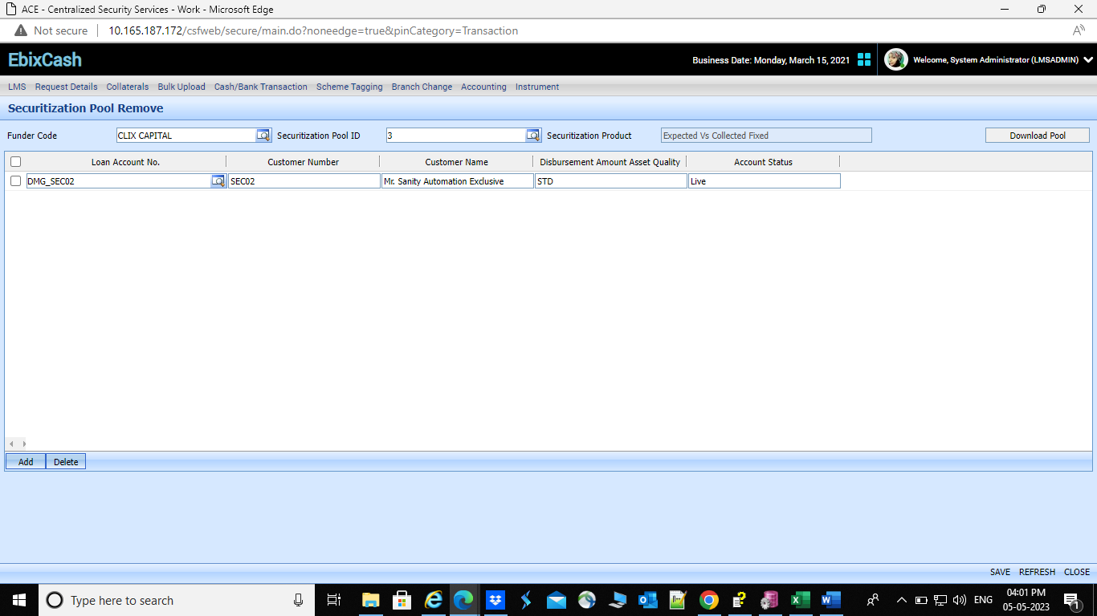
Securtization Pool Remove
This screen allows user to remove any loan account from the uploaded pool, it is applicable after file upload and before contract creation.

Slide 15
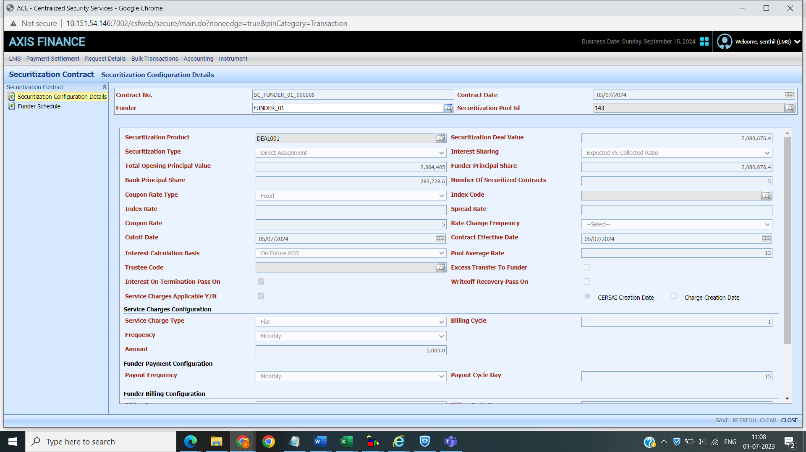
Securitization Contract Creation
From this screen contract will create to securitized the loan. Once the screen will save the loans get securitized.
On this screen final contract will create with all terms and condition agree between funder and seller.
On this screen, we configure cut-off date, contract effective date, coupon rate, charge sharing ratio, interest sharing ratio etc.

Slide 16
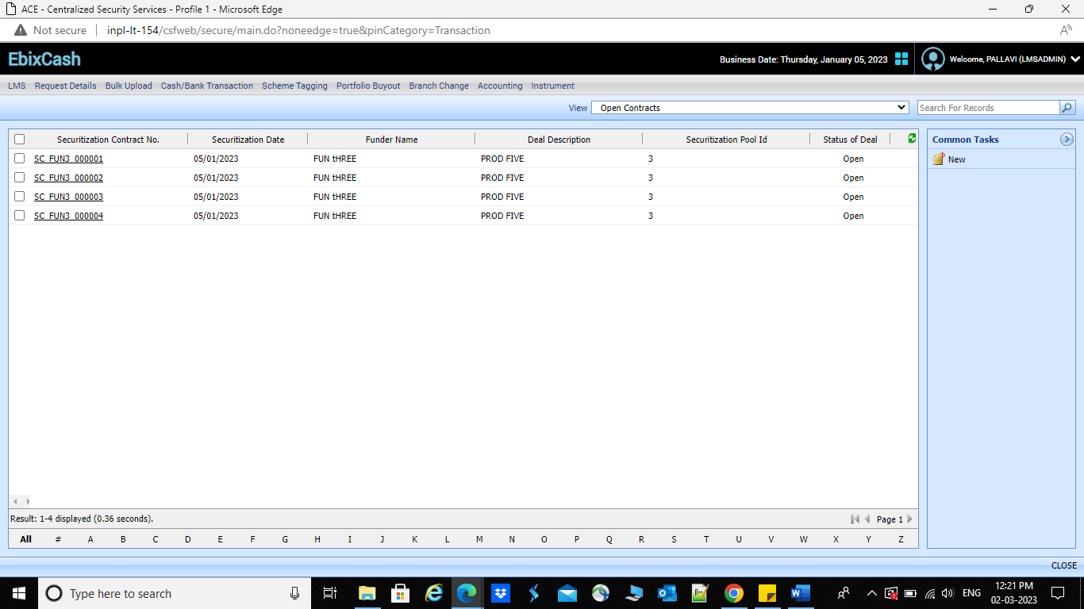
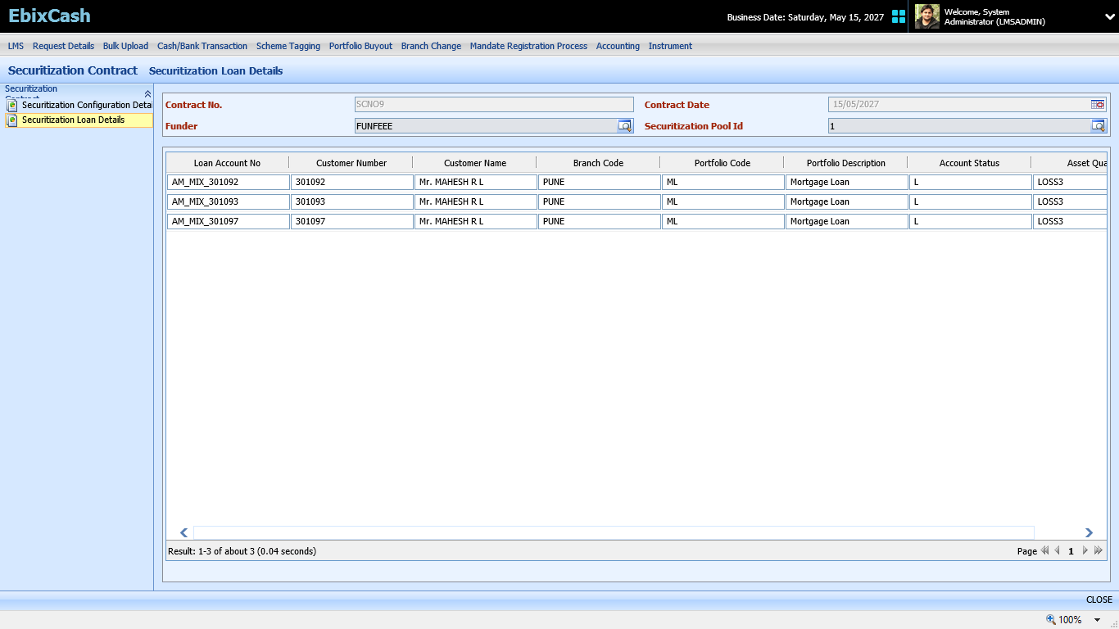
Securitization Contract Creation

Slide 17
Funder Maintenance Screen
Funder Receipt Entry
Funder Receipt History
Funder Payment entry
Funder Payment History
Funder Charges history
Funder Payable Summary
Funder Receivable Summary
Funder Billing History

Slide 18
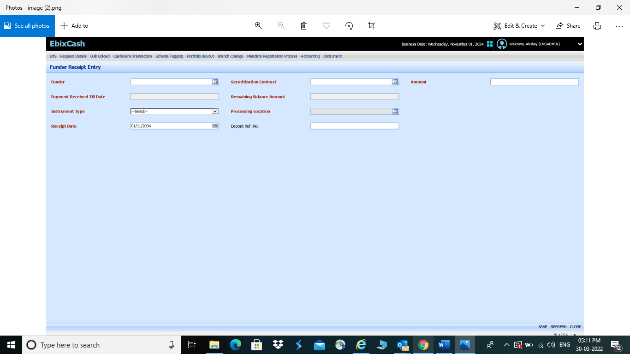
Funder Receipt entry Screen
Here, payment received from funder, details are captured, for which securitization pool funder is making the payment.

Slide 19
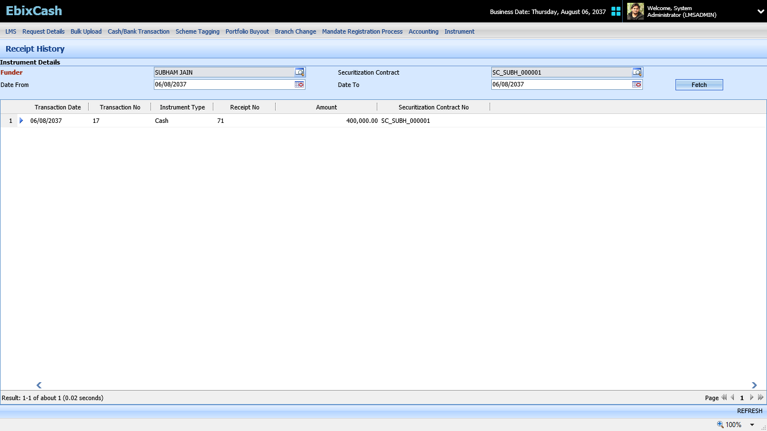
Funder Receipt History
On this screen whatever funder paid to seller that history will display.

Slide 20
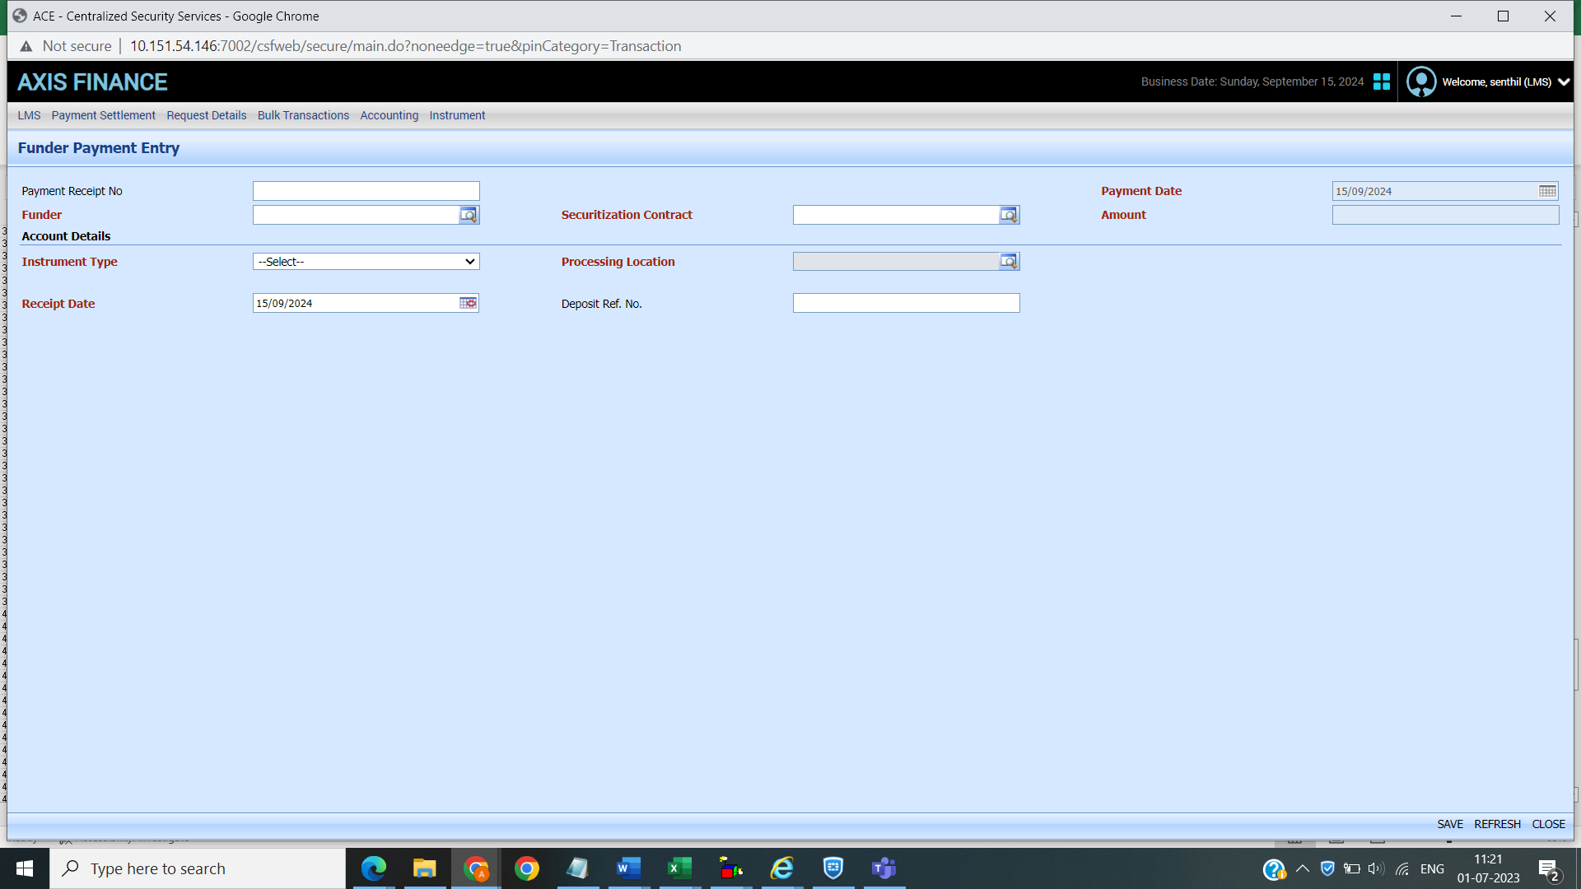
Funder Payment Entry
Processing logic: - Payment made to funder according to frequency is decided at the time of contract
Here whatever payment we are making to funder will be done from this screen. Payment made manual.

Slide 21
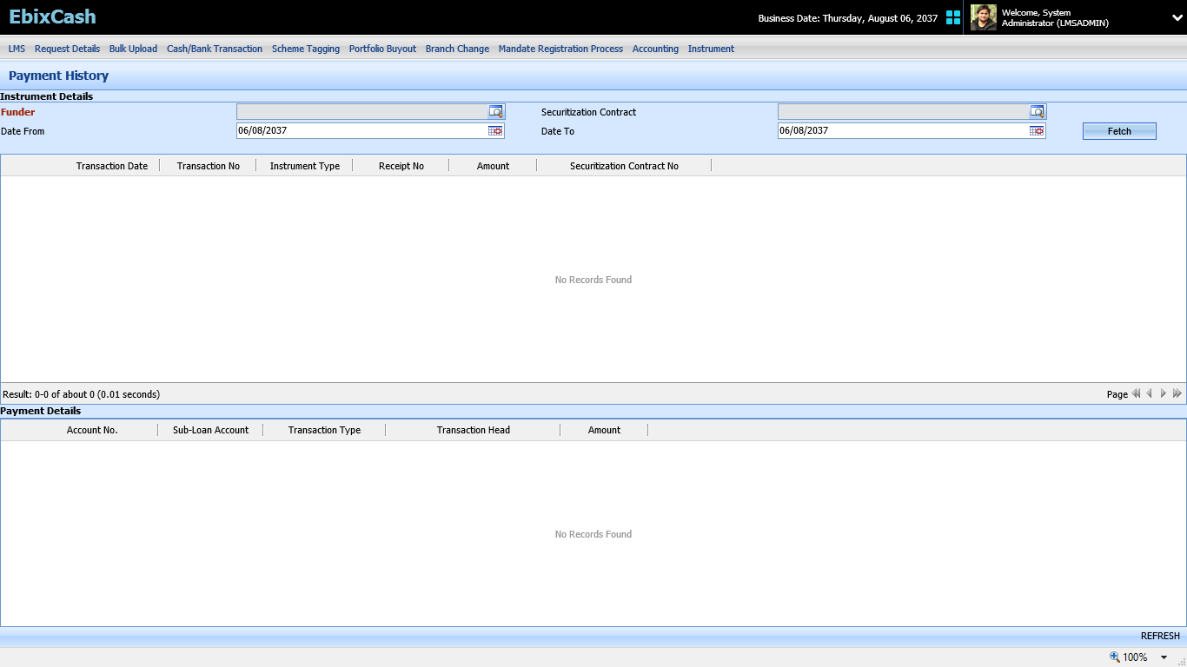
Funder Payment history

Slide 22
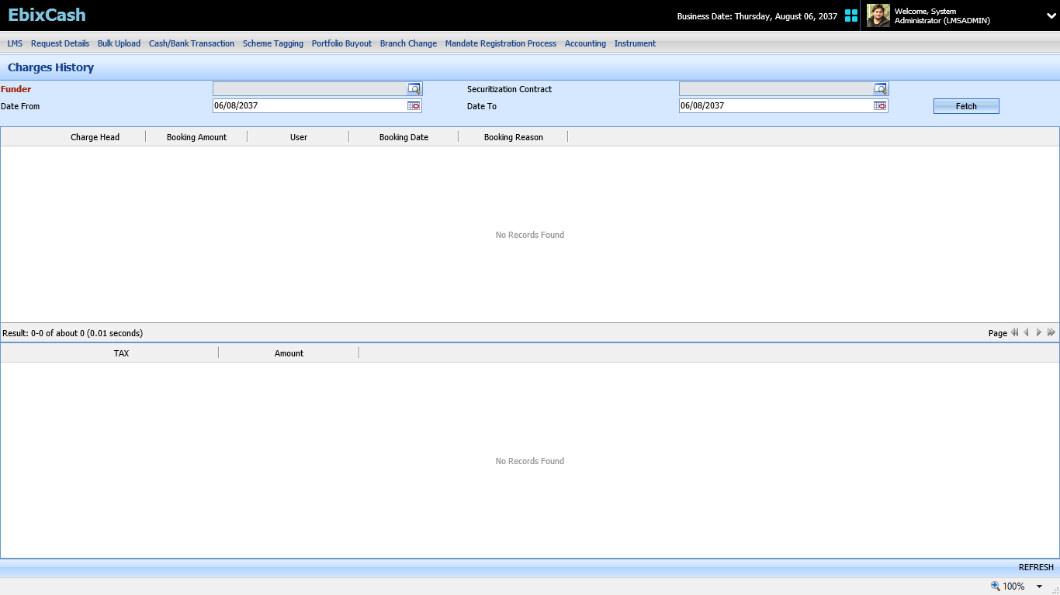
Charge booking history

Slide 23
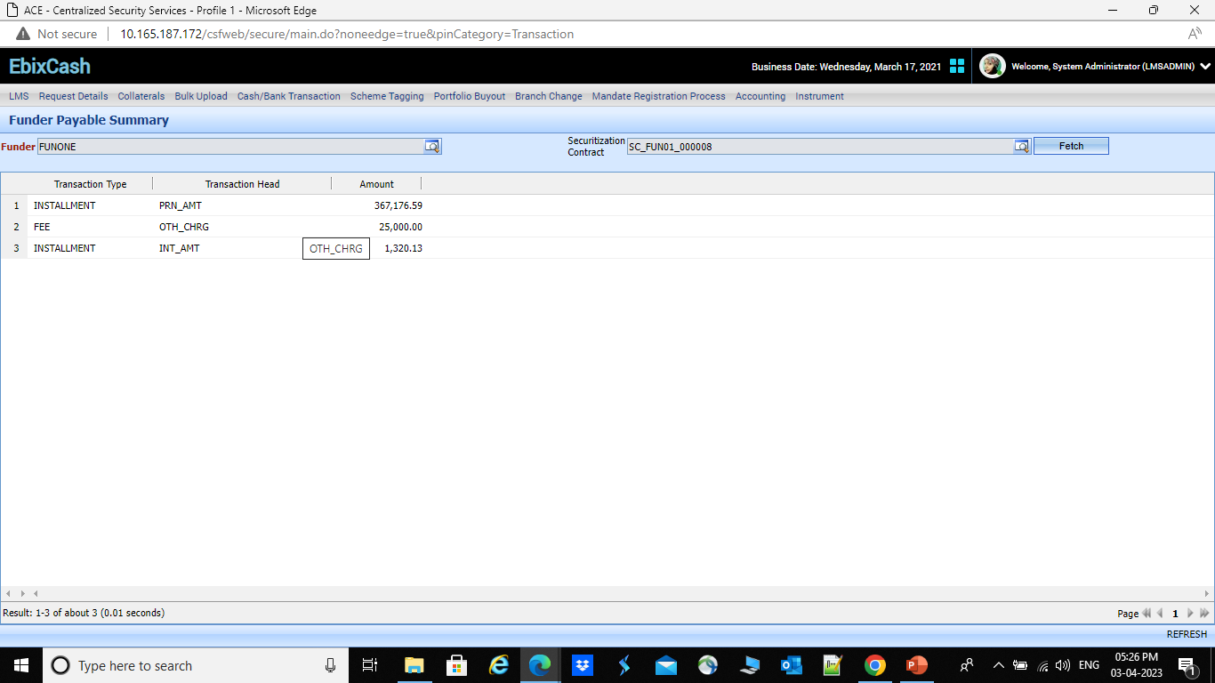
Funder Payable Summary
A new screen needs to develop which shows the summary of payable amount which bank/seller has to pay to funder
Processing logic: This screen is to display the summary of receivable amount from funder which include deal amount(principal) also service fee amount.

Slide 24
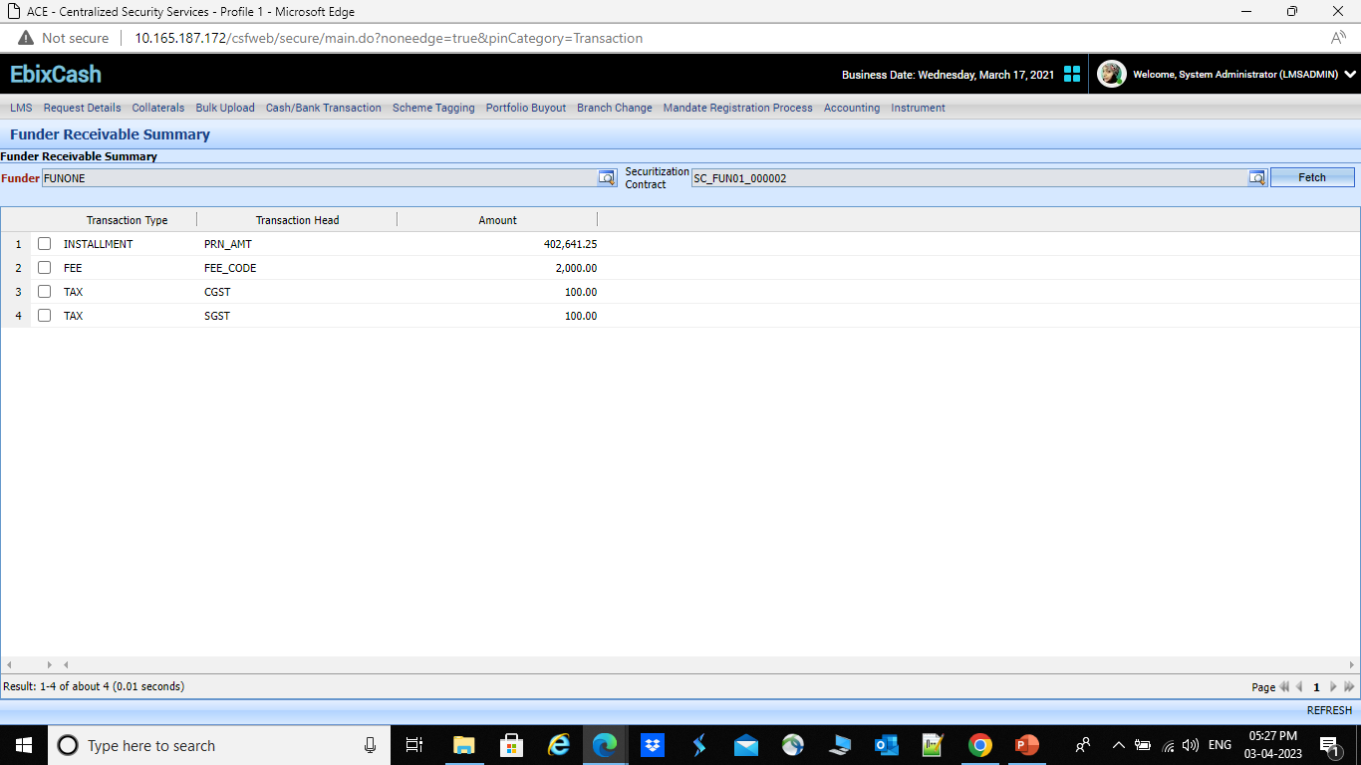
Funder Receivable Summary

Slide 25
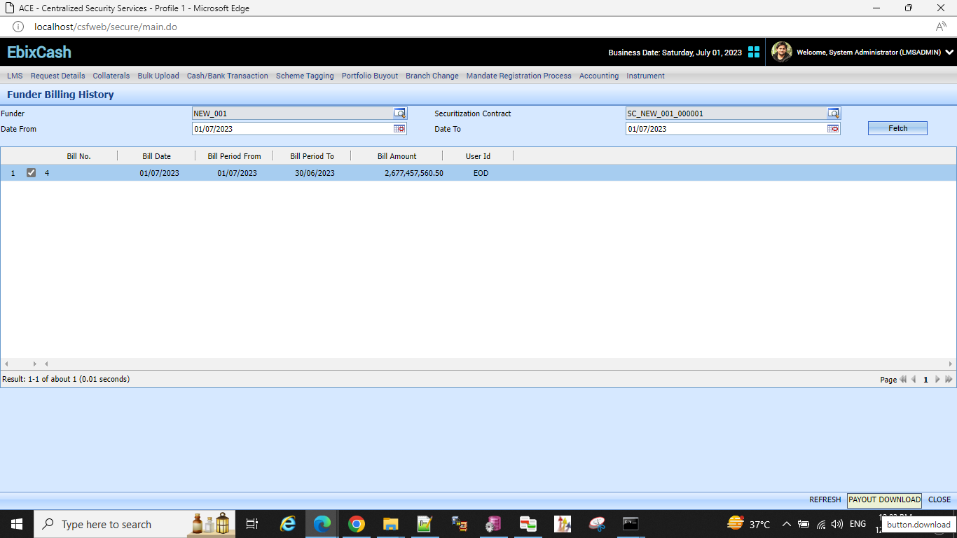
Funder Billing History
From this screen user can download the Payout/billing report of the funder.

Slide 26
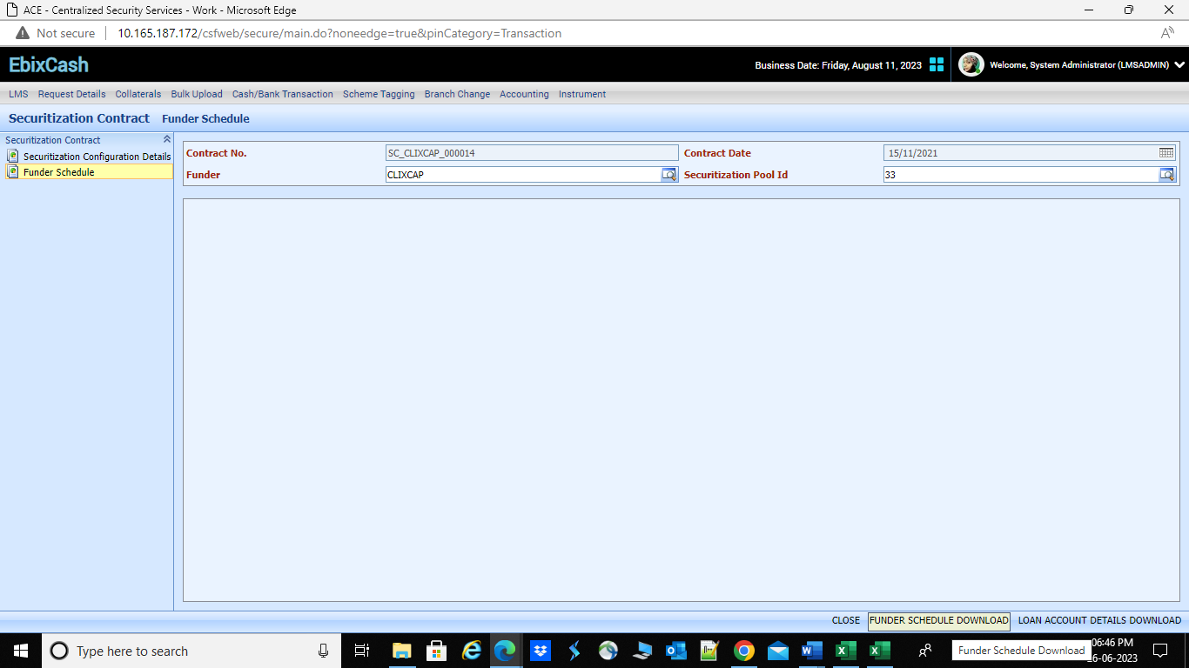
Funder Schedule - Consolidated
Funder schedule also includes the funder sharing schedule and seller sharing schedule which is calculated by sum of individual loan account funder schedule and seller schedule.
Path: LMS->Securitization->Securitization contract-> Funder schedule

Slide 27
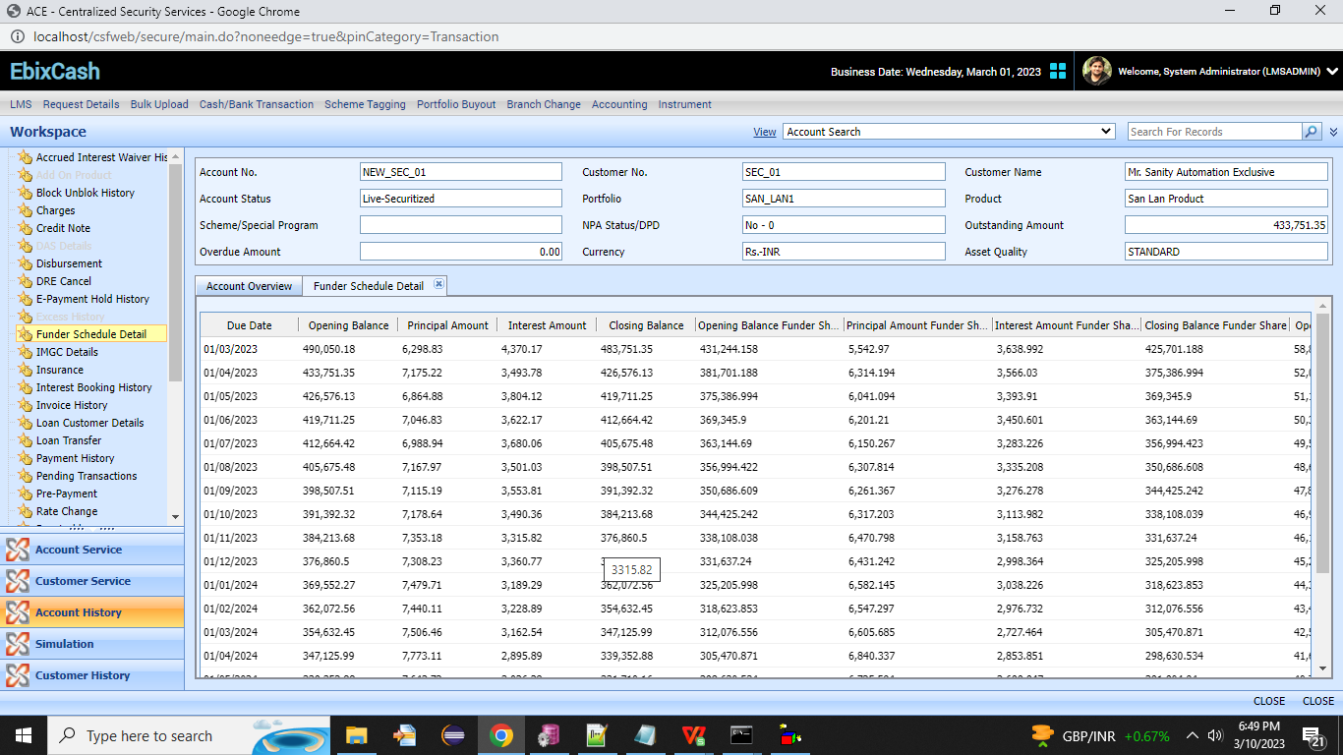
Funder Schedule- Individual loan
A new screen needs to be developed as funder schedule details which display the total outstanding principal of individual selected loan along with EMI details.
Funder schedule also includes the funder sharing schedule and seller sharing schedule.
Path: LMS-> Workspace-> Account search->Funder schedule details.

Slide 28
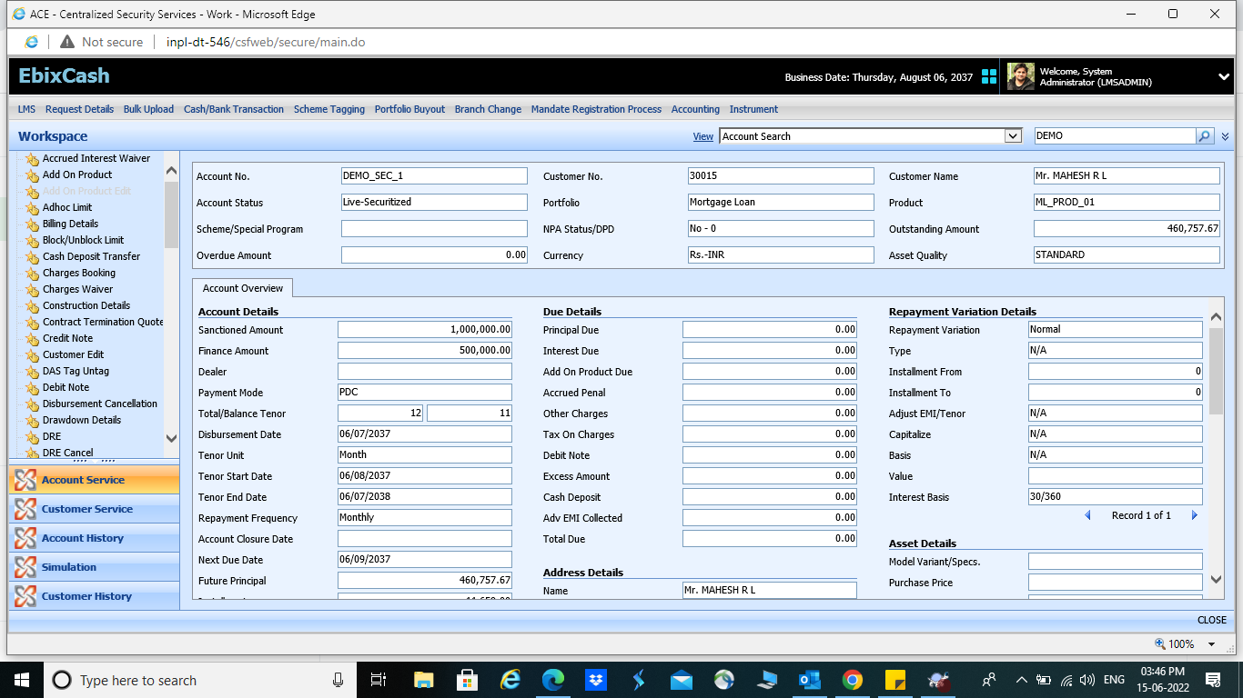
Account Overview Screen After securitization

Slide 29
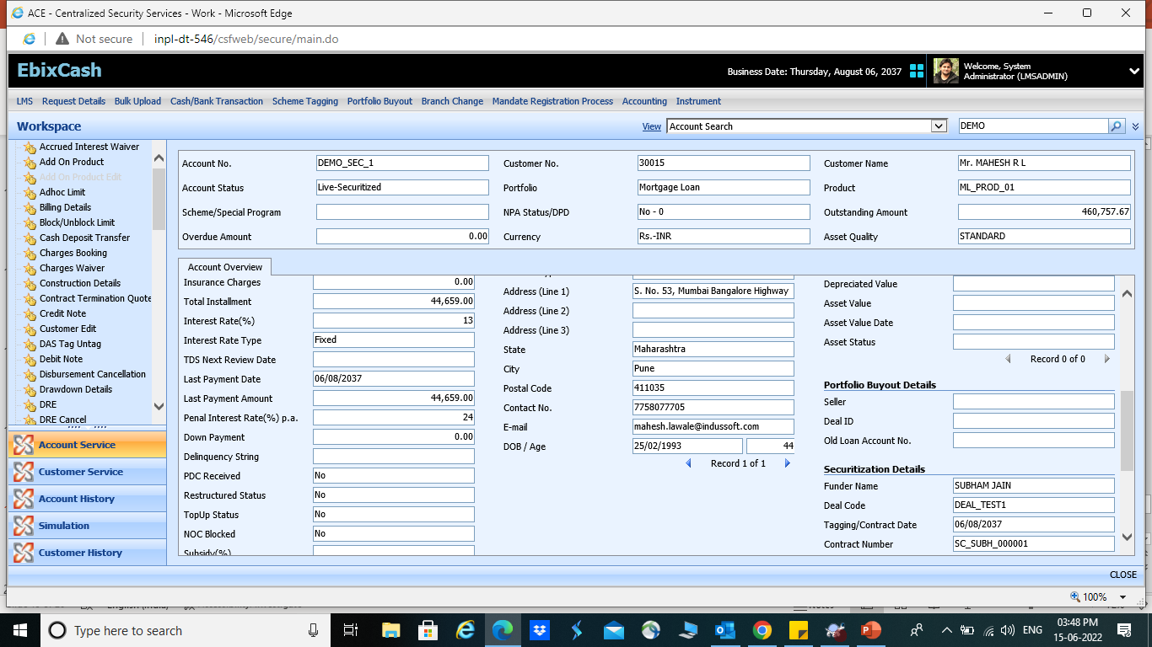
Account Overview Screen After securitization

Slide 30
END
THANK YOU

